Slide 1



Slide 2

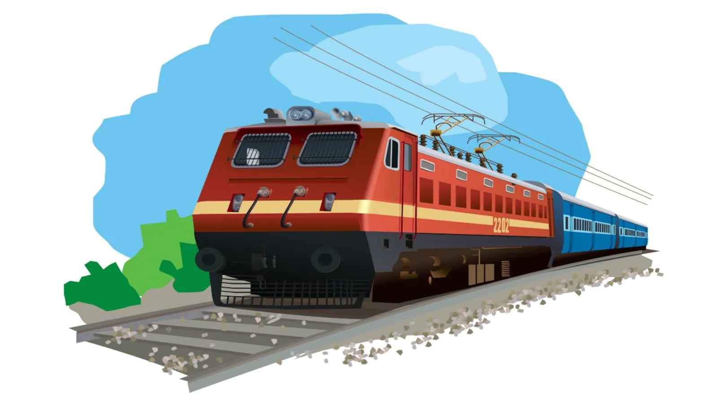
Project
On
Automated Railway Crack Detection

Slide 3
Meet the Team
Student Name | Roll Number
Nowshin Sayara | 2252421004
Latifa Nishat Nishi | 2252421062
Maishan Nadis | 2252421118
Farhan Ishraq | 2252421120

Slide 4




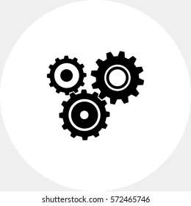

Outline of the Presentation
Introduction
Background
Study
Research
Gap
Objective
Methodology
Conclusion

Slide 5


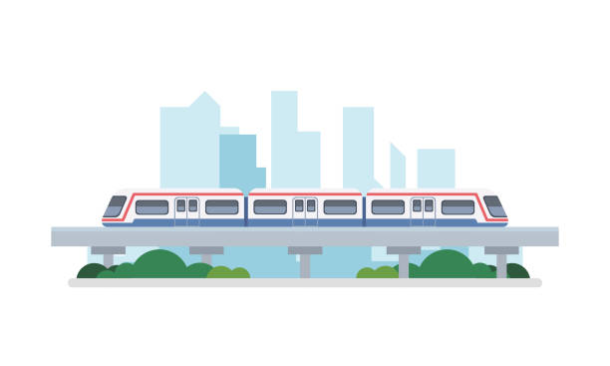
INTRODUCTION
TRAIN

Slide 6
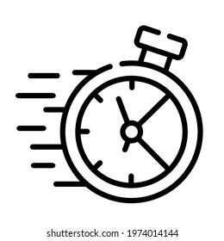


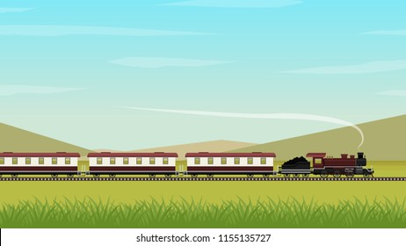
Why TRAIN ?

Slide 7
Table-I: Statistics of the Number of Casualties Caused Due to Train Accidents
Year July-June | Number of Train Accidents | Number of Deaths/Injuries | Number of Train Derailments
2013-2014 | 177 | 185 | 158
2014-2015 | 312 | 246 | 292
2015-2016 | 166 | 36 | 123
2016-2017 | 80 | 10 | 44
2017-1018 | 94 | 52 | 64
2018-2019 | 91 | 56 | 78

Slide 8
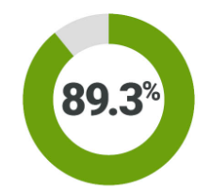
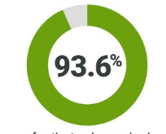
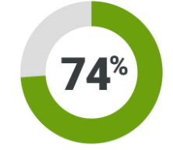
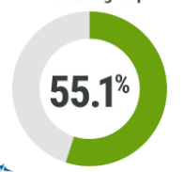
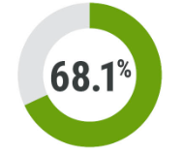
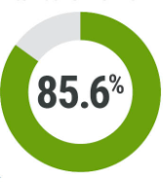
TRAIN Accidents due to DERAILMENT
Year
2013-2014
Year
2014-2015
Year
2015-2016
Year
2016-2017
Year
2017-2018
Year
2018-2019

Slide 9
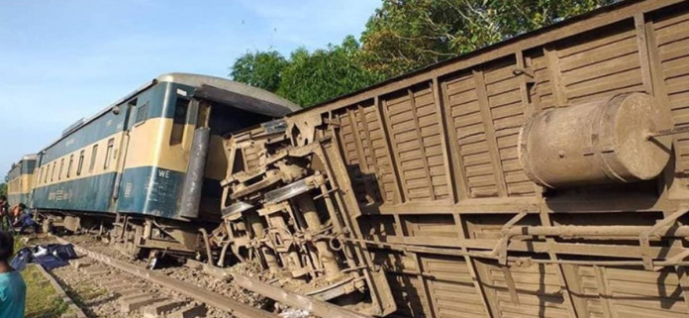
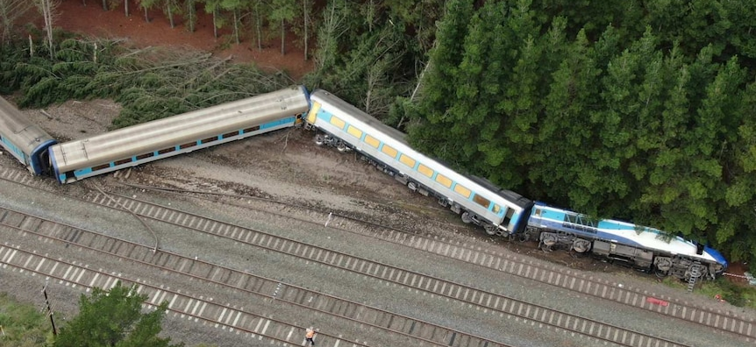
Reasons for Derailment
Temperature related expansion/contraction of the rails
Overloaded vehicles
Environmental obstacles
9

Slide 10
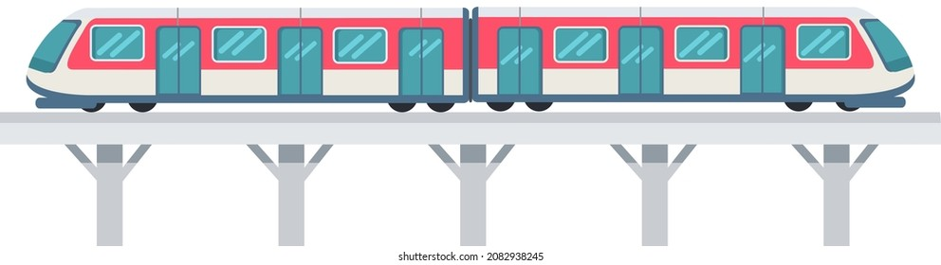


Role of AUTOMATION
CRACK!!STOP!!

Slide 11
Background Study
PPP, GIS
Qinghai-Tibet railway
Probe Vehicle
2G Network, GPS
Fishplate Monitoring System

Slide 12
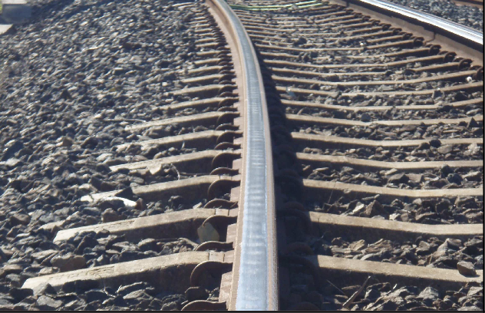
Rail Corrugation, Extensive Use
Real Time Monitoring
Digital 3D Image
Numerical prediction tool

Slide 13
Research Gap
Qinghai-Tibet Railway: Long initialization time
Fishplate Monitoring System: Loosened bolts
Probe Vehicle: Noise sensitive, prone to environmental damage
Numerical Prediction Tool: Sharp curves
Digital 3D Image: Imprecise at high speeds

Slide 14
Objectives
Crack/bending detection
Alerting the driver
Automatic stopping

Slide 15
Methodology

Slide 16
Hardware
Optical Sensor
Arduino Uno
LED
Buzzer
DC Motor
Motor Driver
Wheel
15

Slide 17
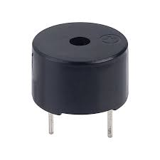
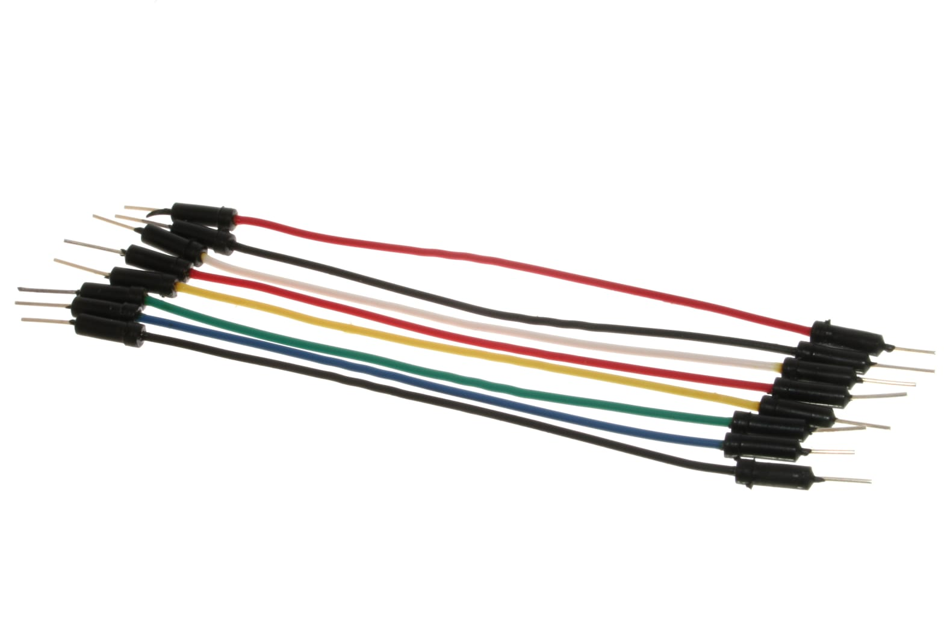
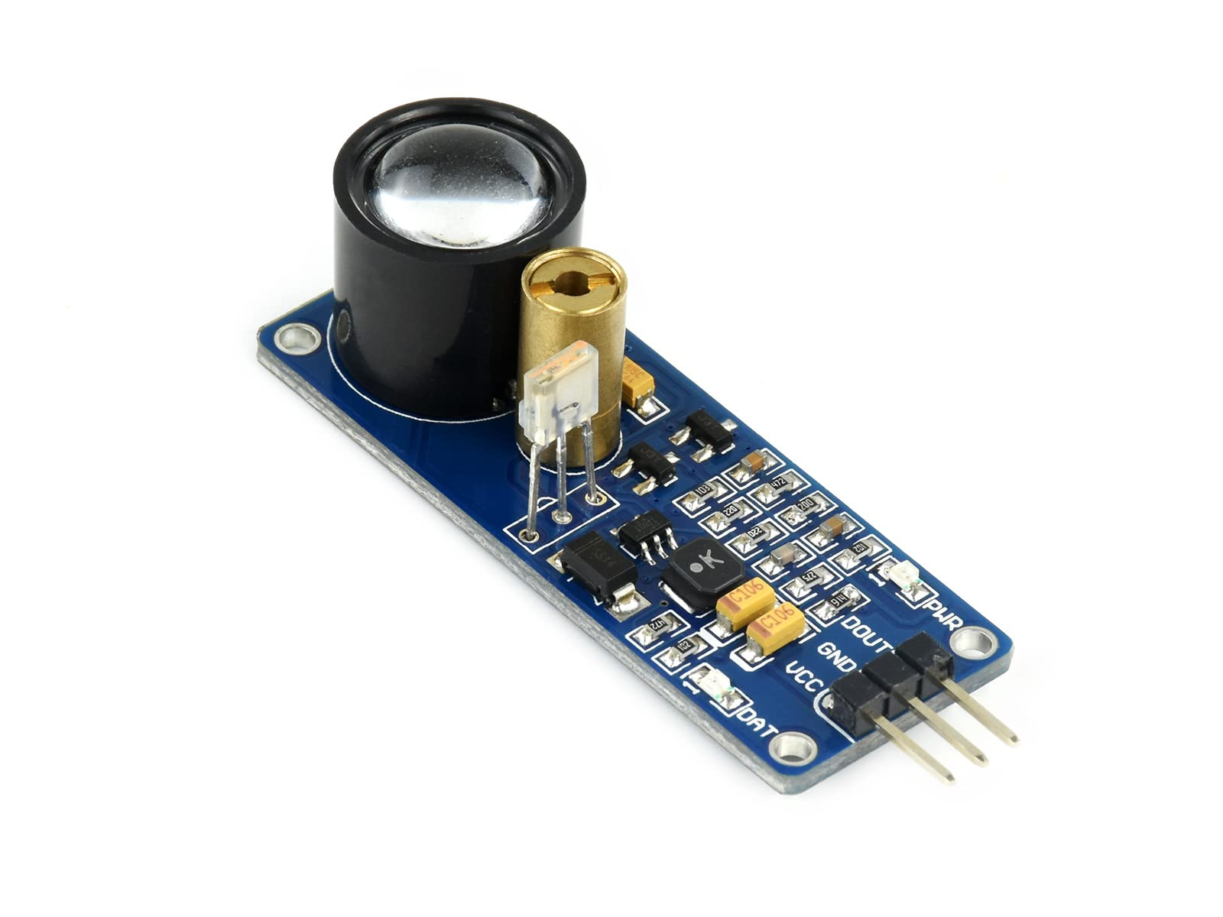
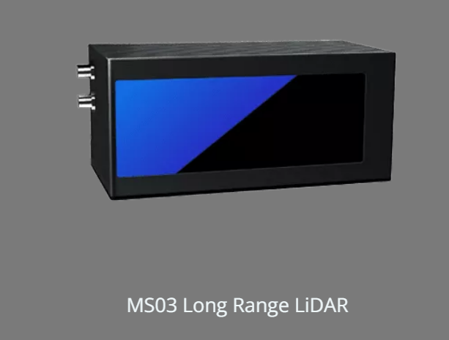
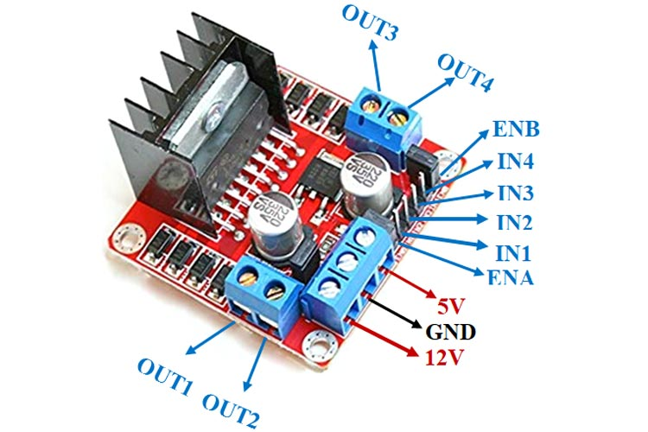
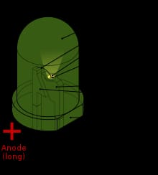
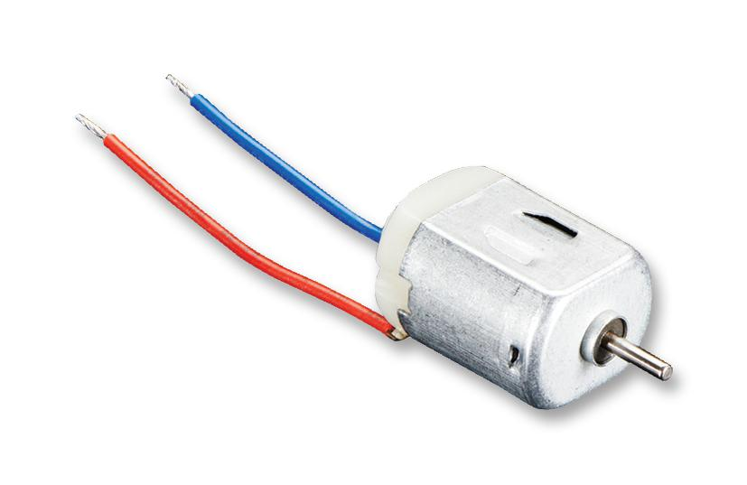
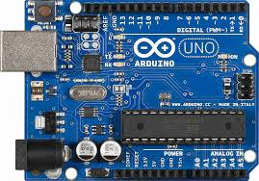
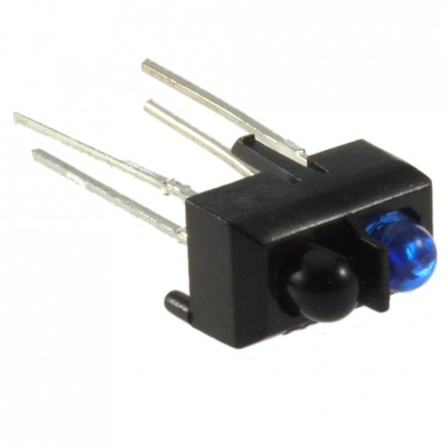

Slide 18
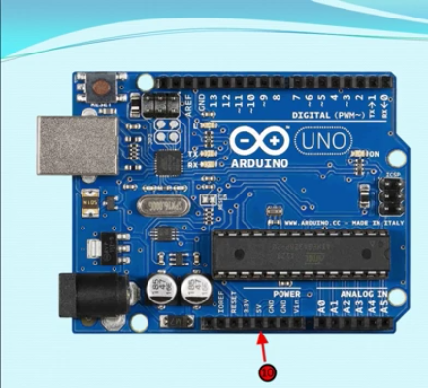
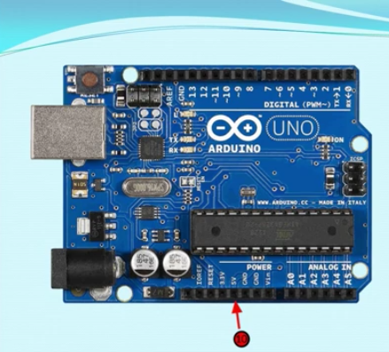
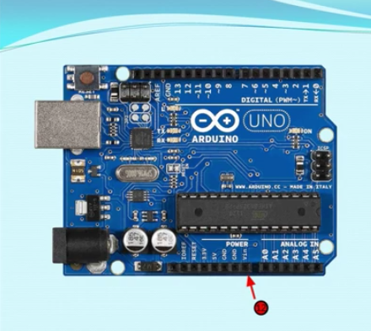
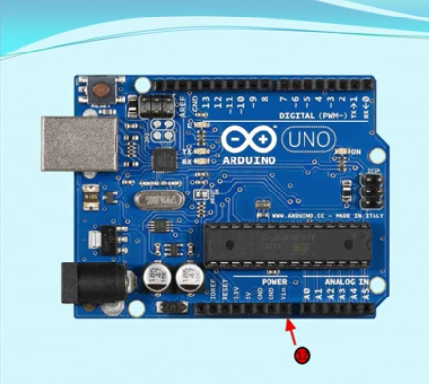

Slide 19
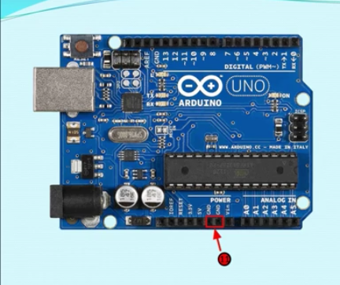
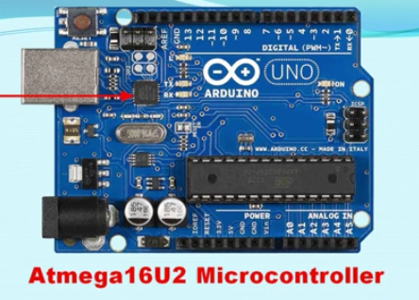

Slide 20
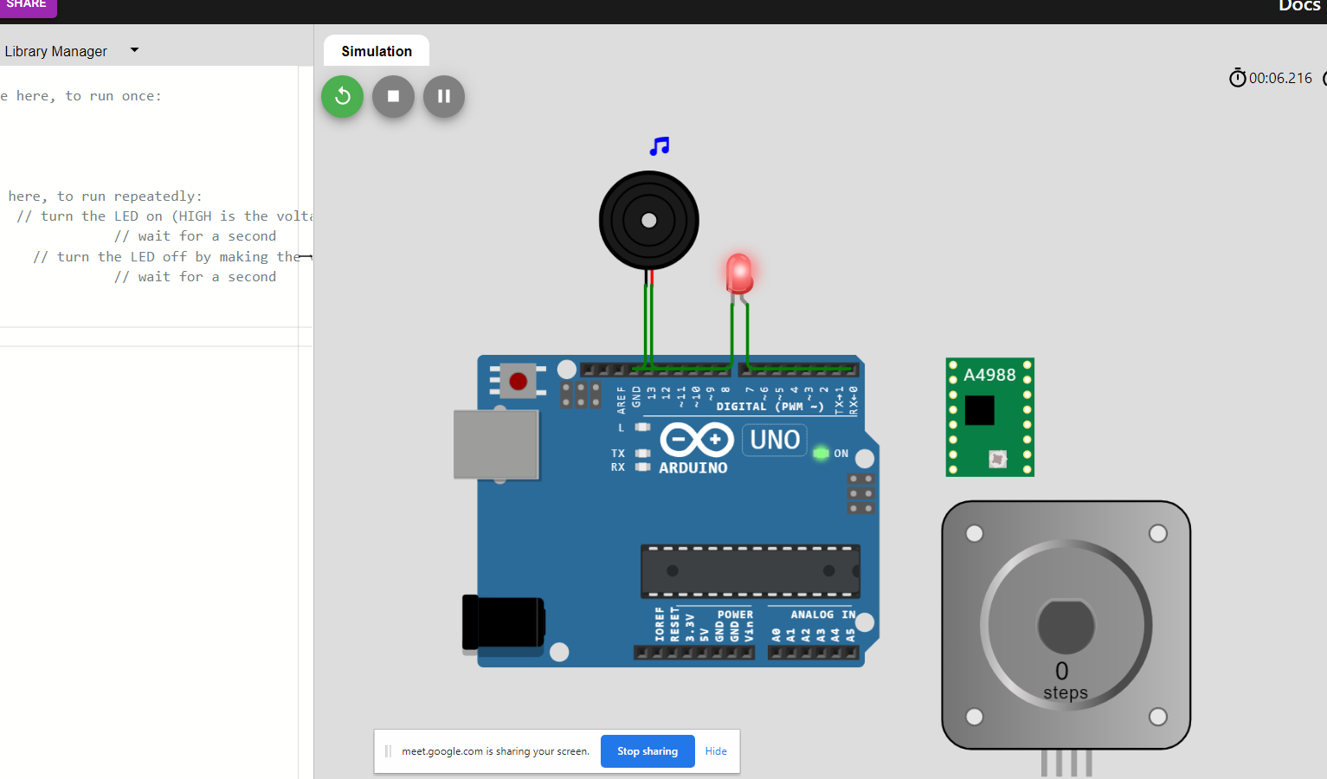
Software

Slide 21
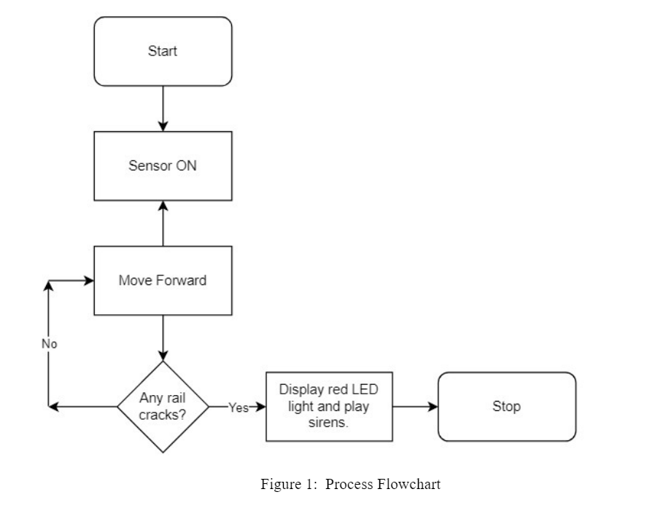
Flowchart

Slide 22
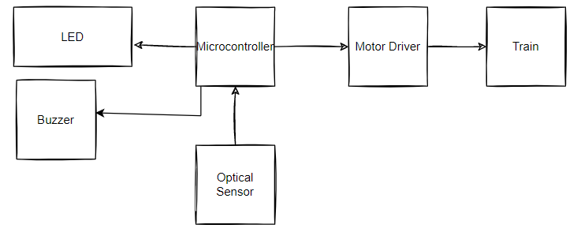
System Diagram

Slide 23
Conclusion
Implementation possible in a limited range.
Cost effective for the government.
Accident prevention.

Slide 24
Future Scope
Rotating sensors
Angled sensors
Sensor range

Slide 25

THANKS EVERYONE!

Slide 26

Q&A

Slide 27
References
Islam, S., Khan, R. A., Biswas, R., "Automatic measurement of rail line expansion joint gaps," 2014 IEEE International Conference on Vehicular Electronics and Safety, 2014, pp. 34-39, doi: 10.1109/ICVES.2014.7063720.
Shajedul Islam, M. (2012) "Study on factors for train derailments in Bangladesh", Department of Civil Engineering, p. Available at: http://lib.buet.ac.bd:8080/xmlui/handle/123456789/434 (Accessed: 23 September 2022).
(2022) Railway.portal.gov.bd. Access Link : “https://railway.portal.gov.bd/sites/default/files/files/railway.portal.gov.bd/page/4ec73cd2_6646_426f_ade5_6c05960865d4/INFORMATION%20BOOK%202019%20(PDF%20Version).pdf” (A.D: 21 September 2022).
Gao, R., Meng, X., Geng, J., Yu, H.S. and Xu, L., 2008, October. Application of real-time precise point positioning and GIS for rail track deformation monitoring of the Qinghai-Tibet Railway. In 2008 11th International IEEE Conference on Intelligent Transportation Systems (pp. 693-698). IEEE.
Tsunashima, H., Kojima, T., Marumo, Y., Matsumoto, A. and Mizuma, T., 2008, June. Condition monitoring of railway track and driver using in-service vehicle. In 2008 4th IET International Conference on Railway Condition Monitoring (pp. 1-6). IET.
Kaewunruen, S., 2018. Monitoring of rail corrugation growth on sharp curves for track maintenance prioritization. Int. J. Acoust. Vib, 23(1), pp.35-43.
Nayan, M.M.R., Al Sufi, S., Abedin, A.K., Ahamed, R. and Hossain, M.F., 2020, December. An IoT Based Real-time Railway Fishplate Monitoring System for Early Warning. In 2020 11th International Conference on Electrical and Computer Engineering (ICECE) (pp. 310-313). IEEE.
Sabato, A. and Niezrecki, C., 2017. Feasibility of digital image correlation for railroad tie inspection and ballast support assessment. Measurement, 103, pp.93-105.

